Slide 1
Forecasting –gold price predictions
team
Anavadhya . C
Naveen basavaraj akki
Vinod s
Basanagouda sb
Lalit pawar

Slide 2
Objective
Data provided us related to gold price. objective is understand under laying structure in dataset and come up with suitable forecasting model which can efficiently forecast the gold price for the next 30 days
This forecast model will be used by gold exporting by gold importing companies to understand the metal price moments and accordingly set there revenue expectations

Slide 3
Project architecture
Model building
deployment
STREAMLIT
Finalise the model
Data cleaning
dataset details and collections
Actual vs predicted
Data analysis

Slide 4
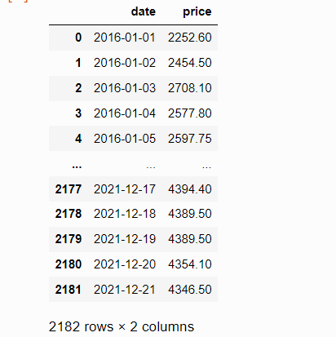
DATA SET COLLECTION AND CLEANING
2182rows and 2 columns
Year range 2016/01/01 to 2021/12/21
Unique date 2182 and price 1876
Null values is zero

Slide 5
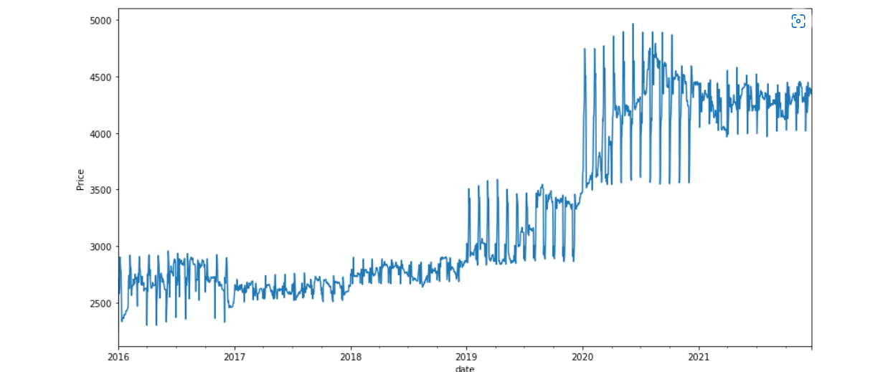
EXPLORATORY DATA ANALYSIS
the line plot which gives the information of the growth (weather the data is increasing , decreasing , or constant

Slide 6
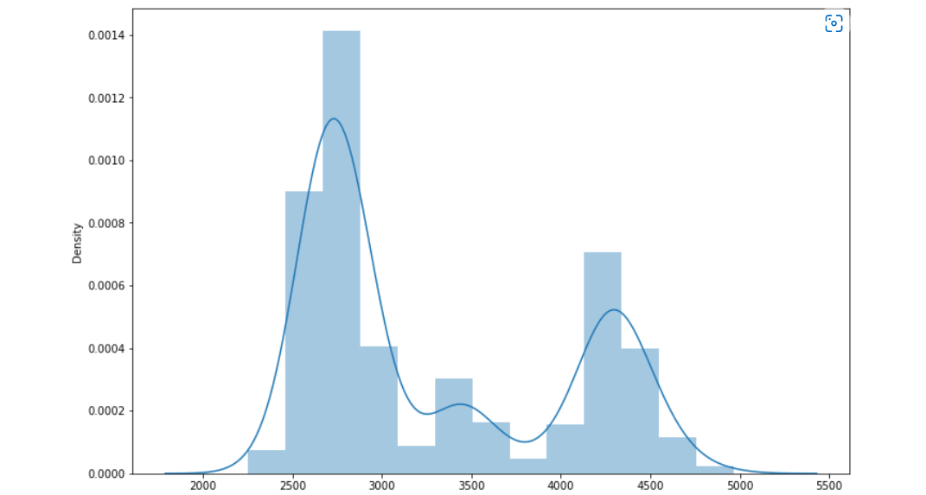
Distribution plot
Here the dataset is not normally distributed

Slide 7
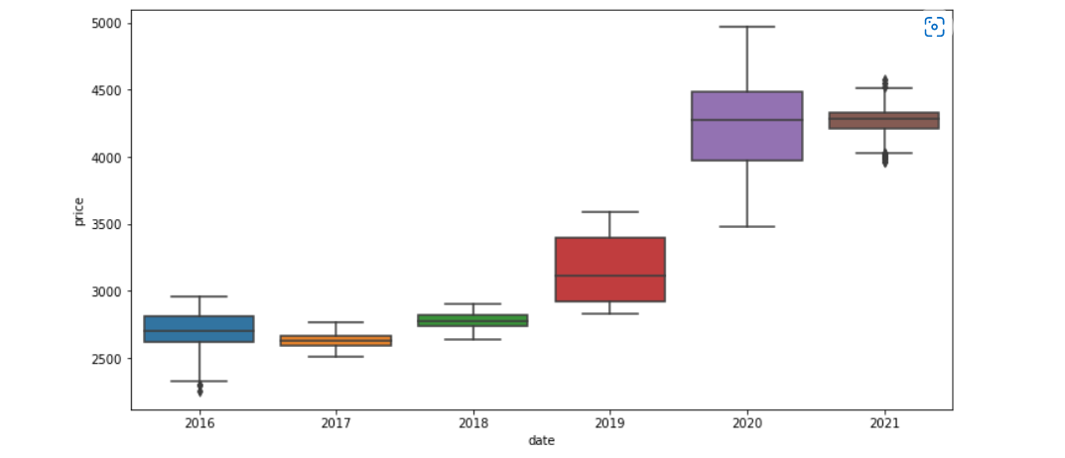
Box plot with price variations

Slide 8
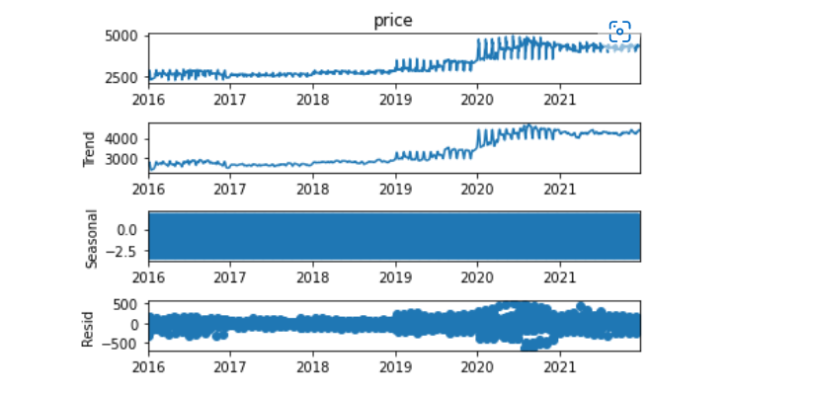
TIME SERIES DECOMPOSTION PLOT

Slide 9
Model building
Simple exponential model
Double or holt exponential model
Triple or holt winter exponential model (‘seasonal additive, trend additive , seasonal multiplicative ,trend multiplicative ,seasonal additive trend multiplicative seonal multiplicative trend additive’ )
ARIMA
SARIMA

Slide 10
ADFULLER TEST
P value 0.9241 , so data is non stationary
We perform adafuller test and come to know that series is not stationary as the p value is grater than 0.05 so null hypothesis is accepted
Data is not stationary so we go for first order differncing and after that we again tested weather the data stationary or not

Slide 11
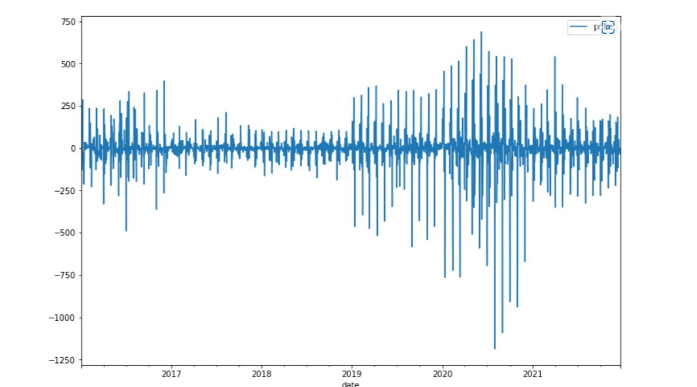
AFTER DIFFERNCING WE AGAIN PERFORM ADFULLER TEST, NOW P VALUE BECOME IS ZERO HENCE THE DATA IS STATIONANRY
P VALUE IS 0.00 SO DATA IS STATIONARY

Slide 12
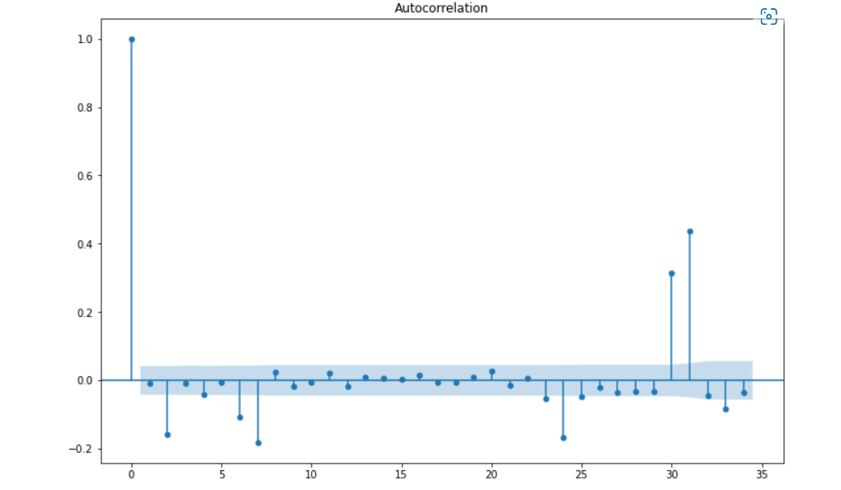
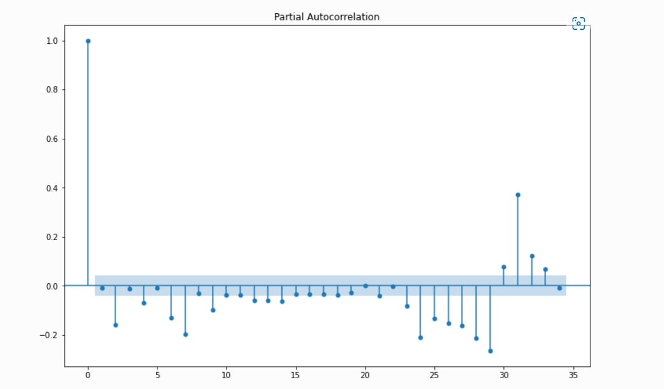
ACF AND PACF AFTER STATIONARY

Slide 13
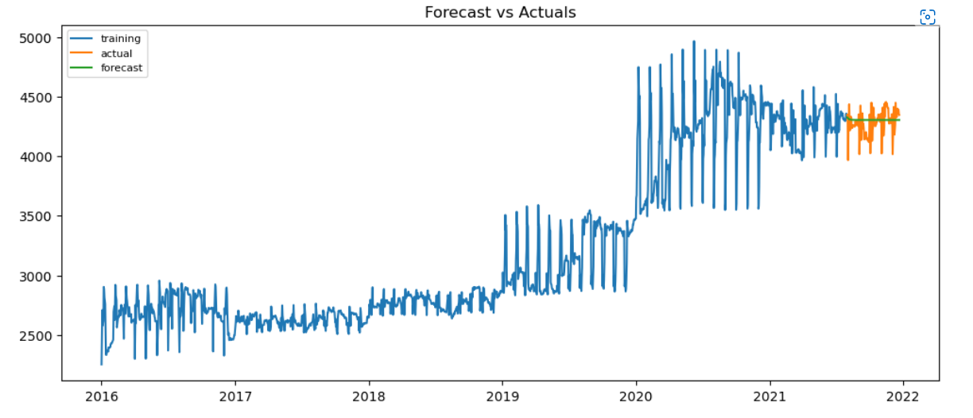
Forecast vs actual

Slide 14
FINALISING THE MODEL WITH ARIMA
We used ARIMA model for forecasting because, we are getting least error value compare to the other models
MAPE(mean absolute percentage error) value (1.763158)

Slide 15
Challenges faced
Research on history of gold
Deciding model building techniques

Slide 16
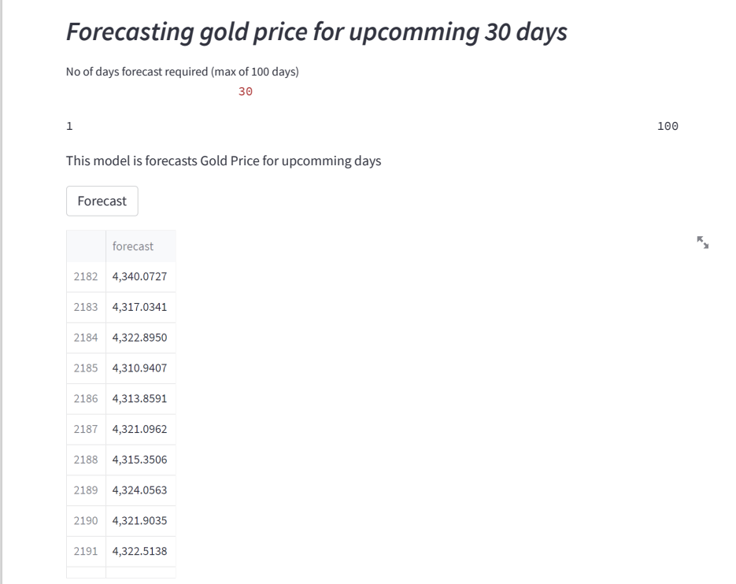
Deployment(Using streamlit)

Slide 17
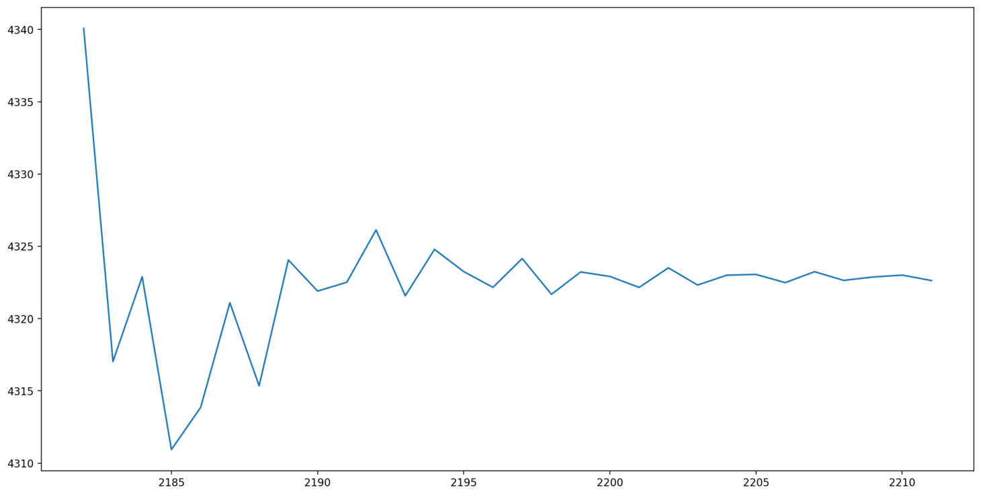
Deployment graph

